Slide 1

Lessons Learned from Marijuana Legalization
Justin Luke Riley
The Marijuana Accountability (SAM affiliate)

Slide 2
Why
Who
What

Slide 3



Slide 4


Slide 5
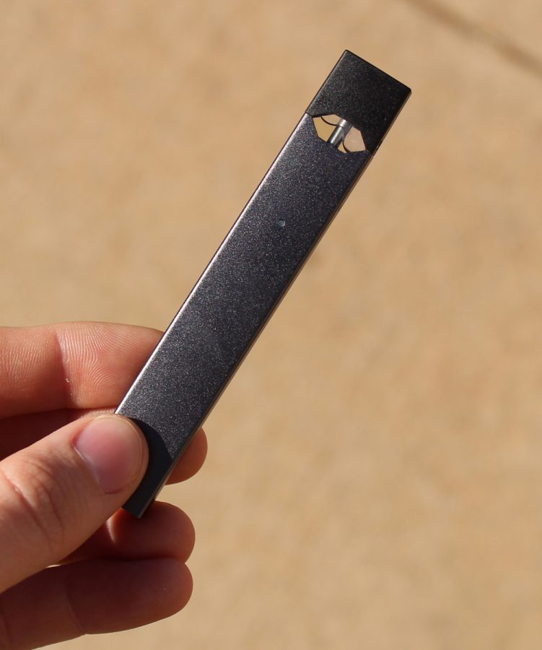

Slide 6
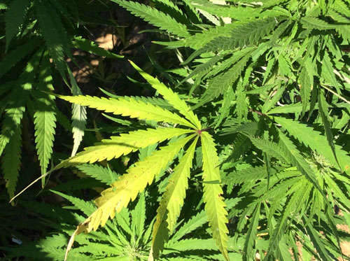

Slide 7
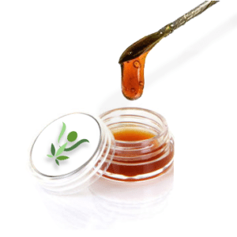

Slide 8
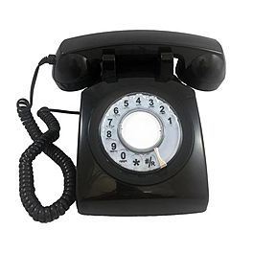


Slide 9


Slide 10

What is SAM?
A 501(c)(3) non-profit, educational organization funded by volunteers & private organizations
Our mission:
  Educate citizens on the science of marijuana
  Promote health-first, smart policies and attitudes that decrease marijuana use and its consequences

Slide 11
Groups SAM collaborates with
American Society of Addiction Medicine
American Academy of Pediatrics
American Academy of Child and Adolescent Psychiatry
Other leading public health authorities
Over 30 state affiliates, including:
  Treatment centers
  Recovery groups
  Prevention organizations
  Law enforcement
  Leading medical authorities
  Volunteer citizens

Slide 12

Two Organizations, One Mission
SAM Action is dedicated to promoting healthy marijuana policies that do not legalize drugs.
Active at all levels of national, state, and local policy-making
Invests in and starts organizations to promote smart marijuana policies
SAM’s mission is to educate citizens on the science of marijuana and to promote health-first, smart policies and attitudes that decrease marijuana use and its consequences.
Brings light to and conducts research into marijuana’s negative effects

Slide 13
What is the Marijuana Accountability Coaltion?
A 501(c)(4) non-profit, educational organization funded by volunteers & private organizations
Our mission:
  We fearlessly investigate, expose, challenge, and hold the marijuana industry accountable.

Slide 14


The false dichotomy: “Legalization OR incarceration?”
vs
Icons: Ddigital Innovation, FR; Iconathon; Edward Boatman (The Noun Project)
Icons: Milky – Digital Innovation;

Slide 15

Three separate issues that often get conflated
1
2
3
Medicinal use of compounds derived from marijuana/other drugs
Legalization of marijuana or other drugs for “non-medical” use
Penalizing drug users/ ”decriminalization”

Slide 16
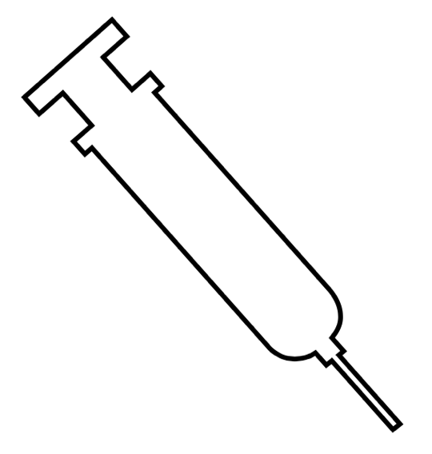

Why talk
POT
During an opiate epidemic?

Slide 17
Marijuana use goes hand-in-hand with increased prescription opioid abuse
Source: Olfson M., et al. Cannabis Use and Risk of Prescription Opioid Use Disorder in the United States. Am J Psychiatry 2017. https://doi.org/10.1176/appi.ajp.2017.17040413.

Slide 18
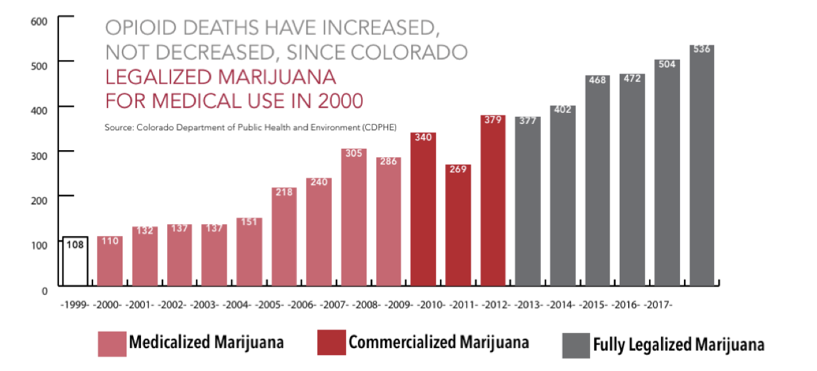

Slide 19
Today’s marijuana

Slide 20
Not This…
Source: 3CCannabis

Slide 21
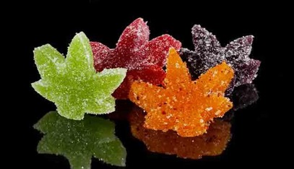
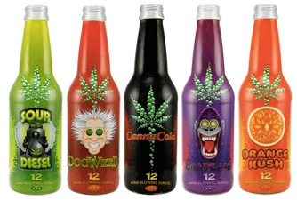

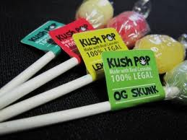
…But This
Source: Marijuana Business Journal; other open source media

Slide 22
Marijuana has become significantly more potent since the 1960s
THC:
Psychoactive Ingredient
CBD:
NON-Psychoactive Ingredient
Source: Mehmedic et al., 2010

Slide 23
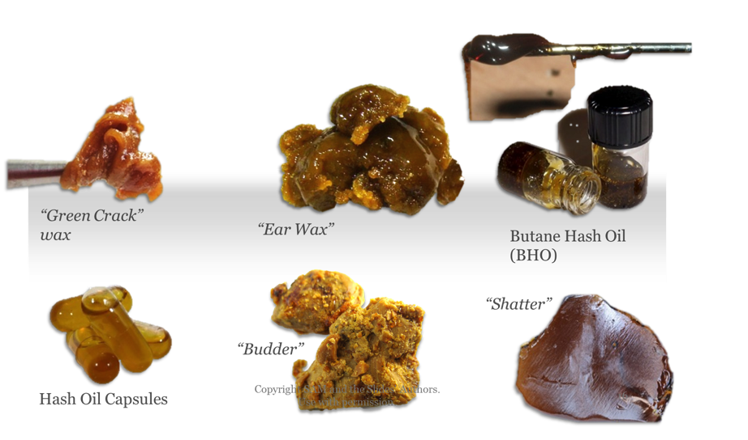
Marijuana is not “just a plant” anymore – derivatives contain up to 98% THC

Slide 24
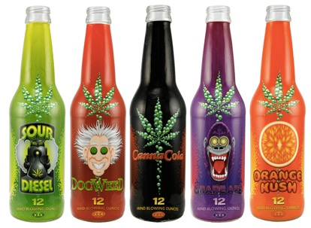
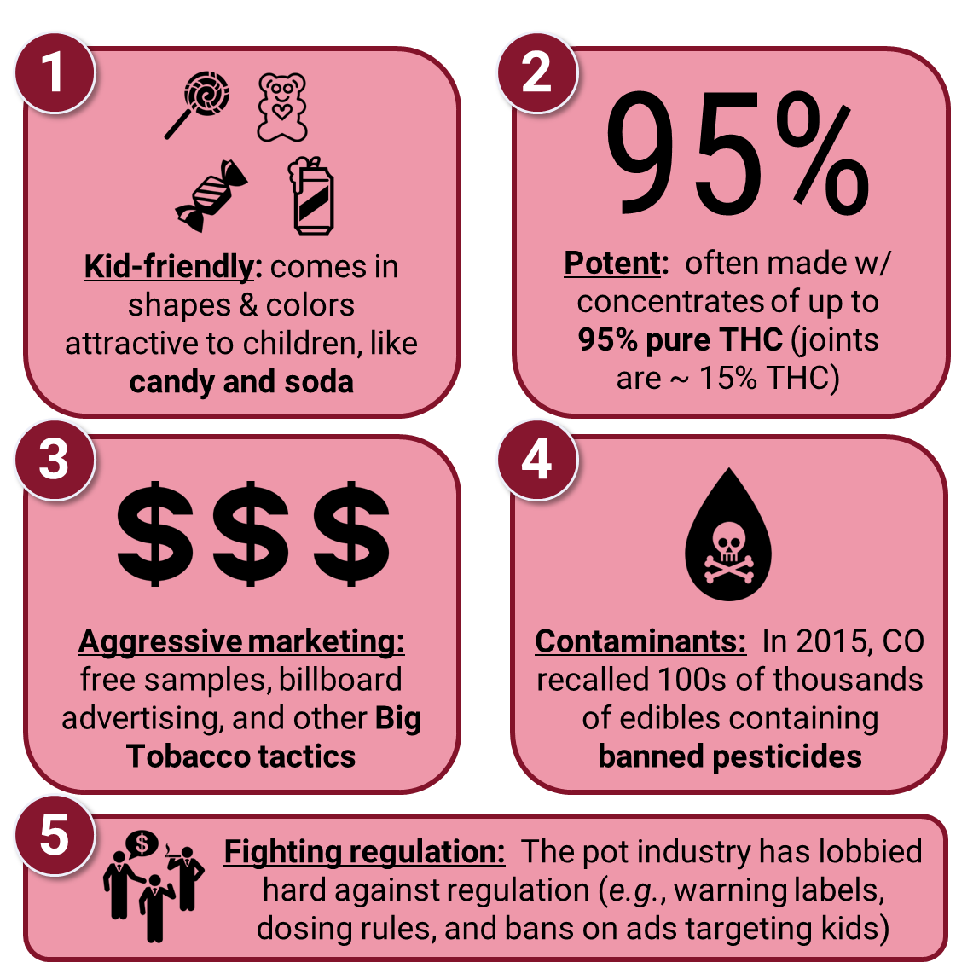
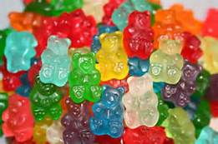

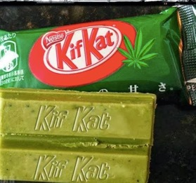
The Industry Today
Source: Marijuana Business Journal; other media. Icons: Marianna Nardella; Anton Gajosik; Petra Prgomet; Joey Golaw; Creative Stall; Luis Prado; Aha-Soft

Slide 25
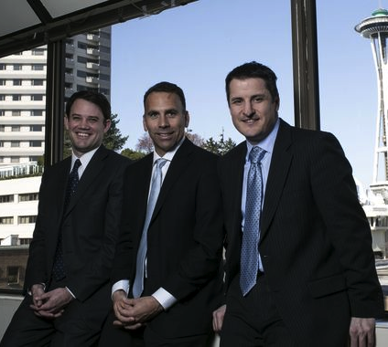
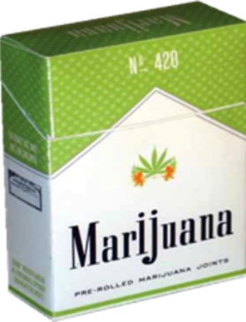

Slide 26
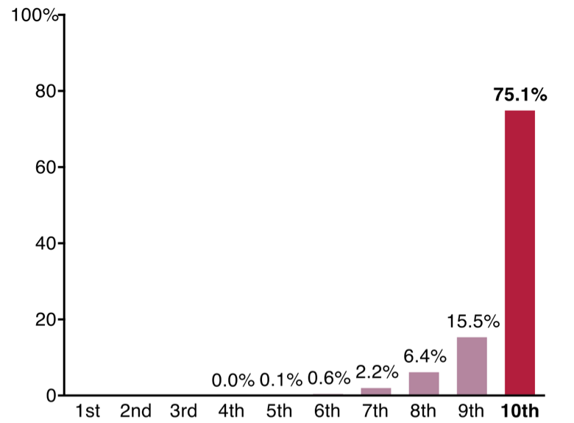
The top 10% of the population make up 75% of the alcohol industry’s U.S. sales
Avg. 10 drinks a day
Source: Cook, P. J. (2007). Paying the tab: The economics of alcohol policy. Princeton, NJ: Princeton University Press

Slide 27
What have we learned?

Slide 29
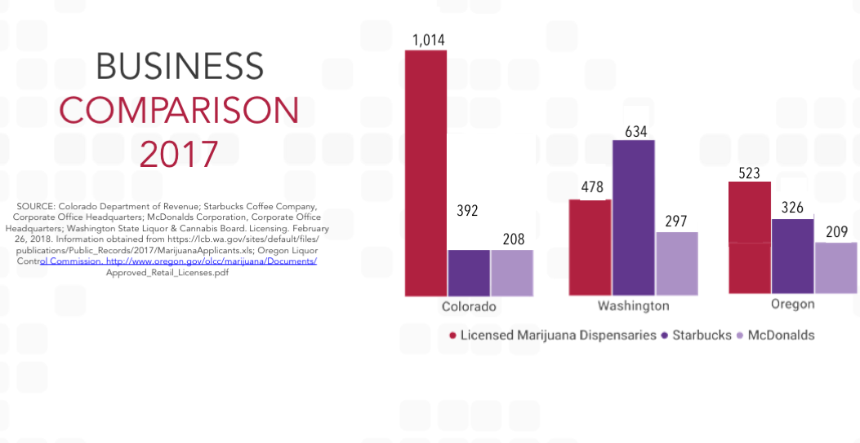

Slide 30
Results of Legalization
Commercialization
  CO now #1 first-time youth use rate in the country
  Rampant advertising/commercialization
  A thriving underground market – white, grey, and black.
Promotion of Special Interests
THC caps have failed (State of CO)
Limit on # and location of stores have failed (Denver)
Money diverted to general fund (eg WA)

Slide 31
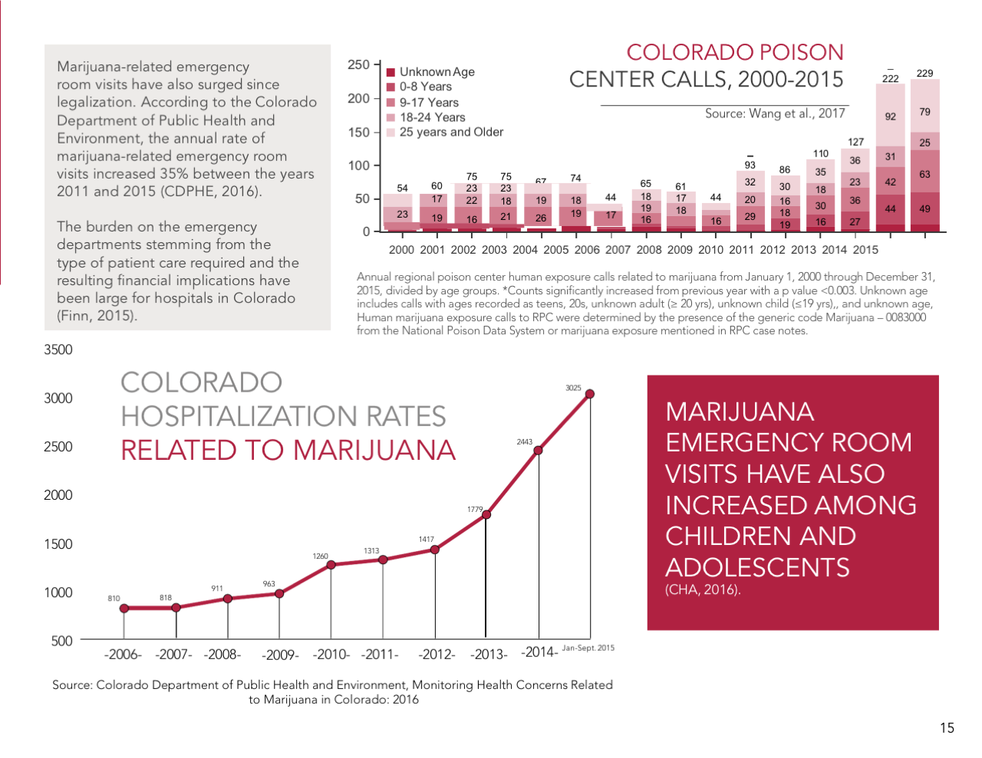

Slide 32
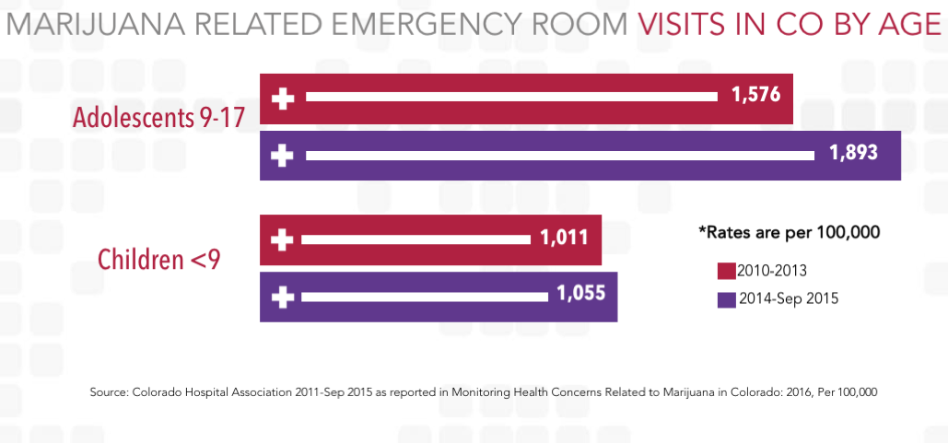

Slide 33
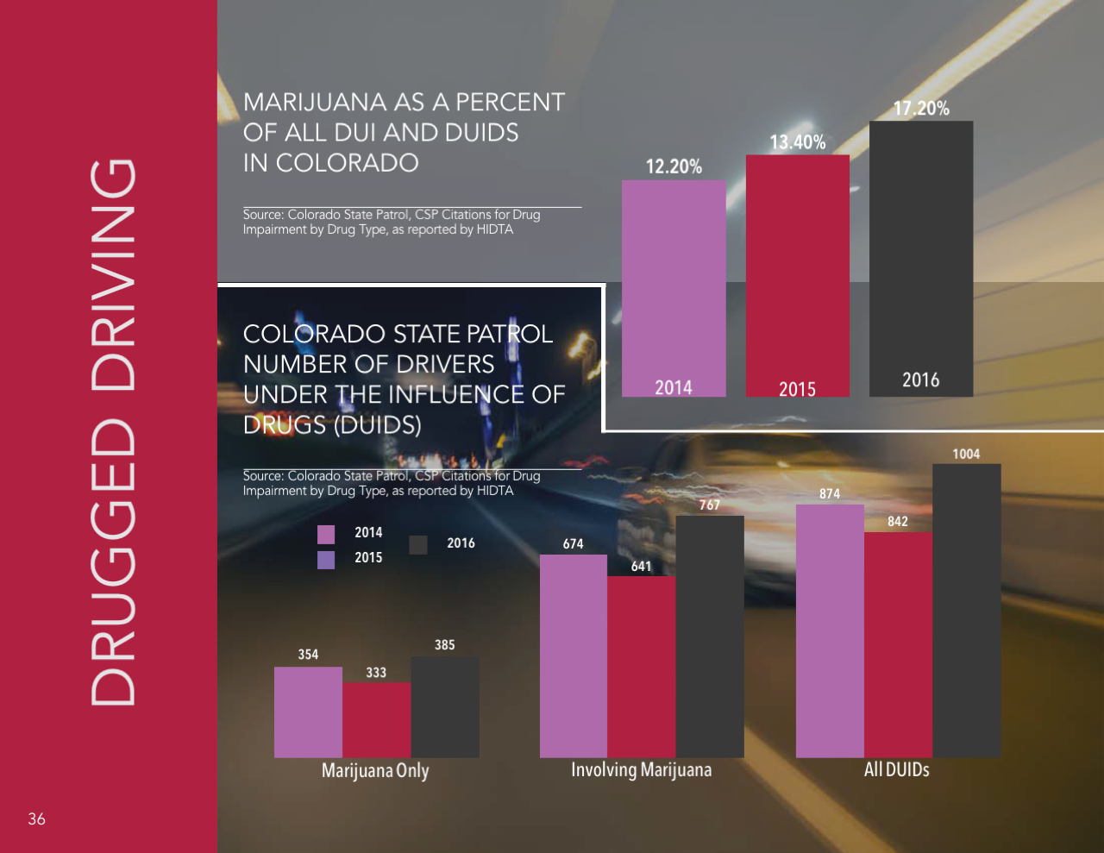

Slide 34
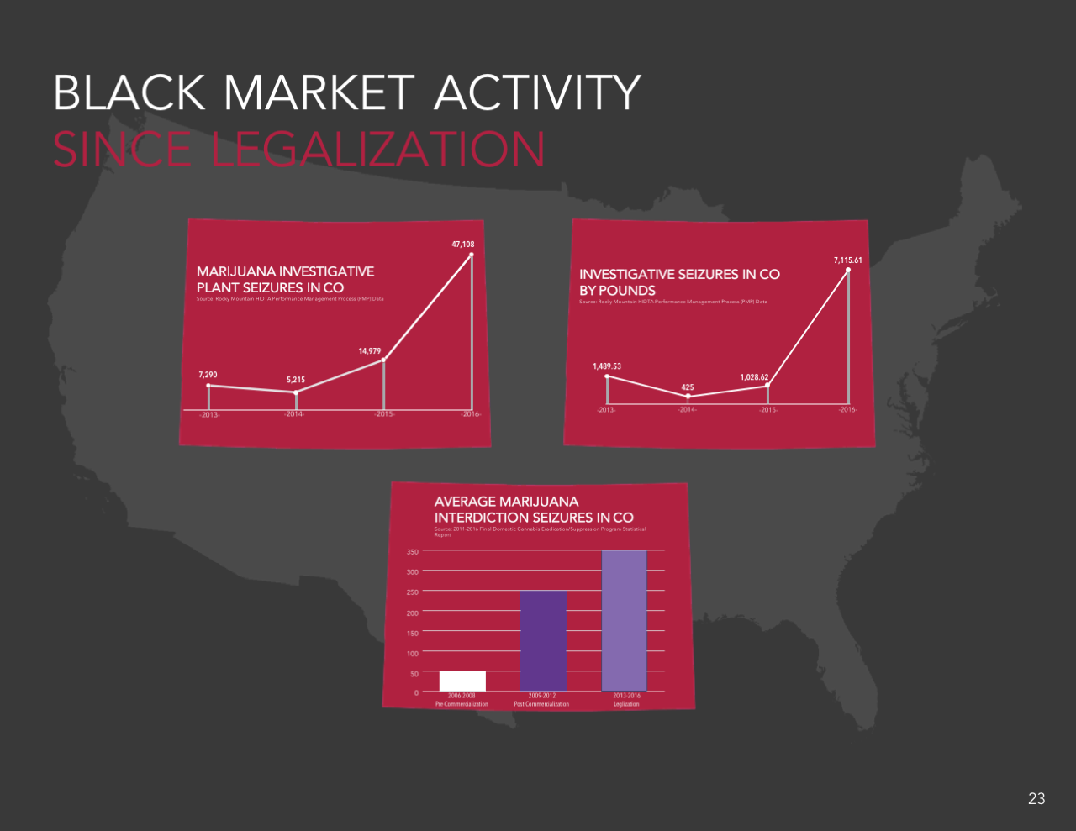

Slide 35
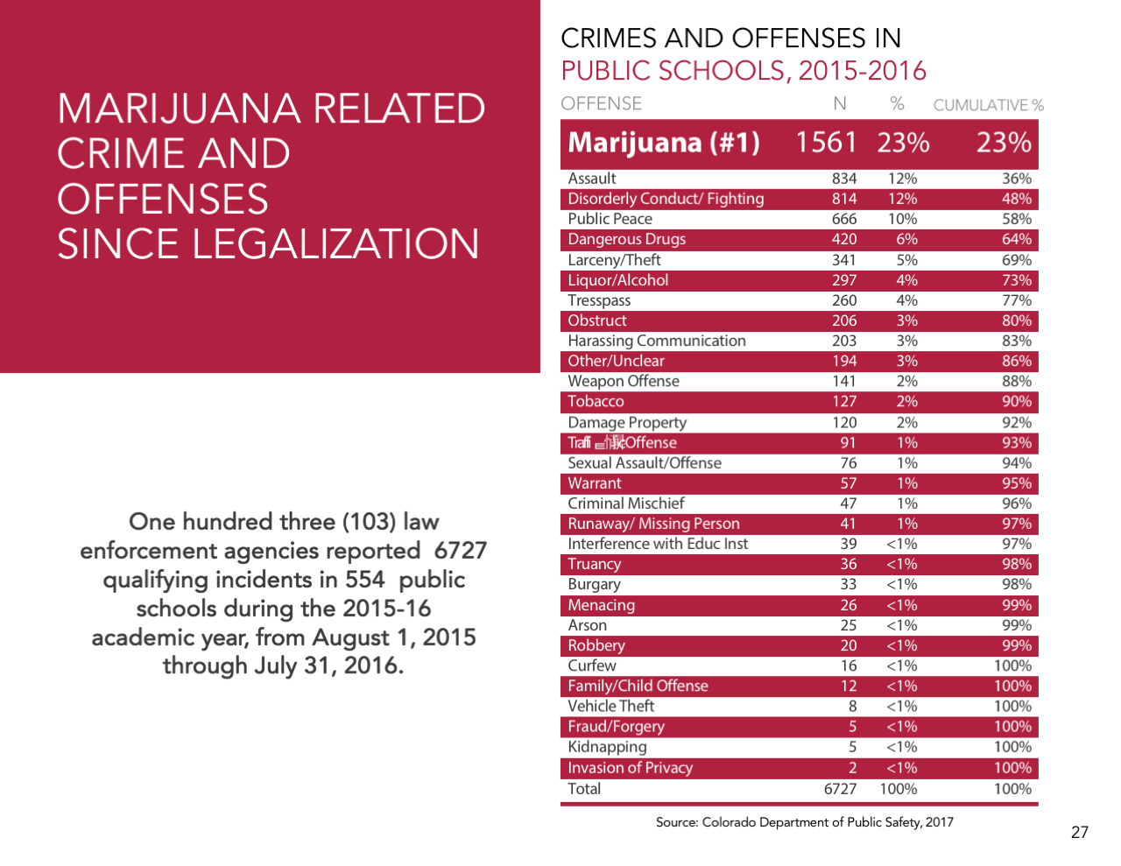

Slide 36
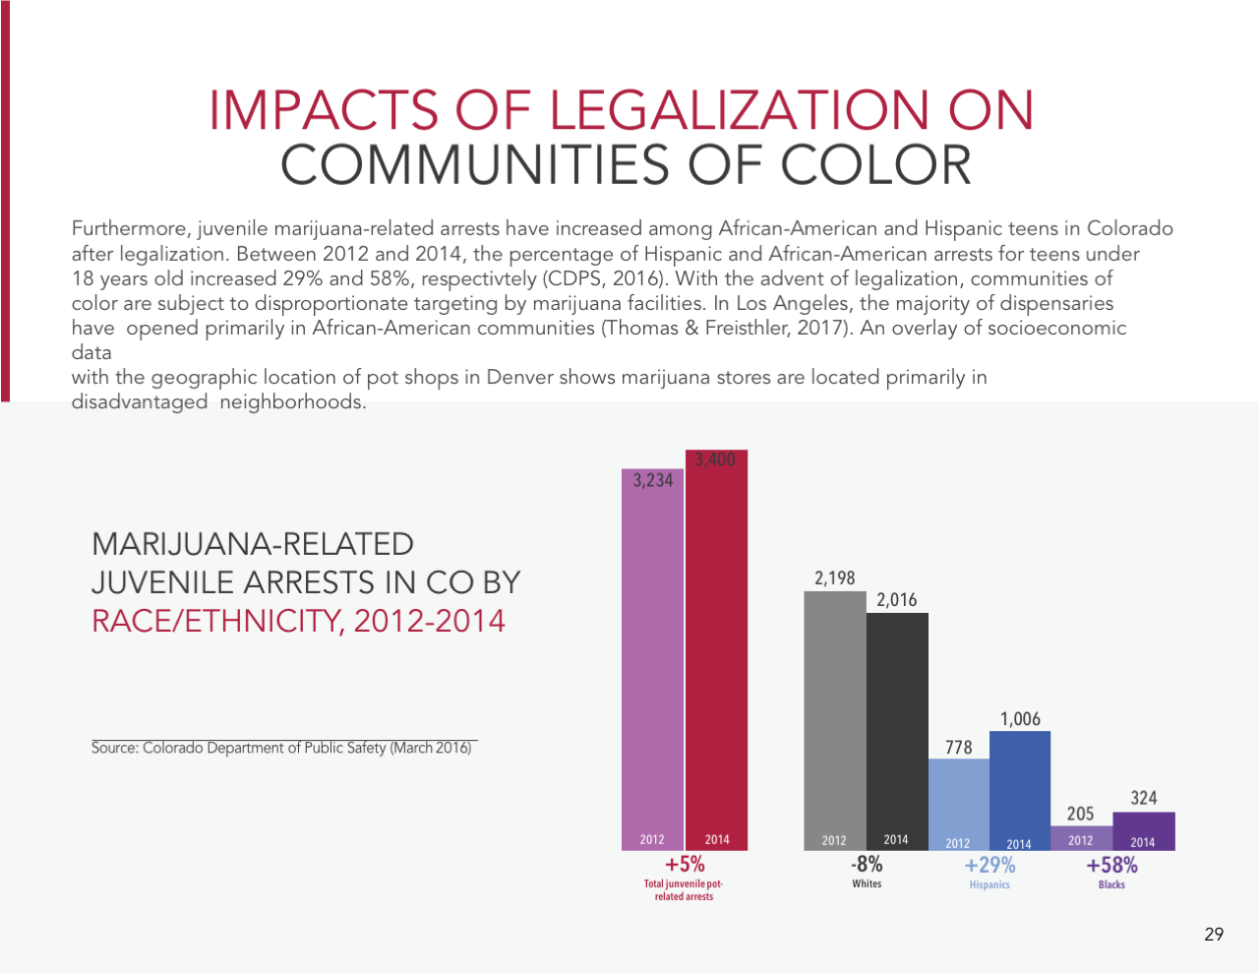

Slide 37
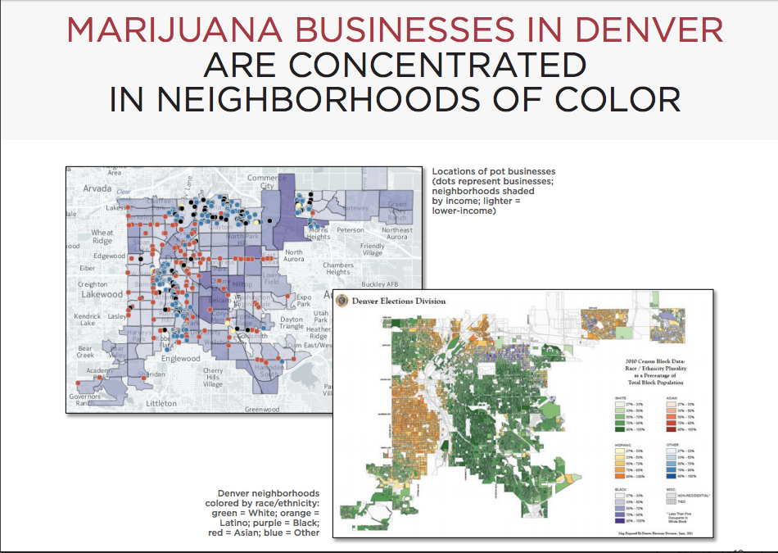

Slide 38

Are you better off?

Slide 39
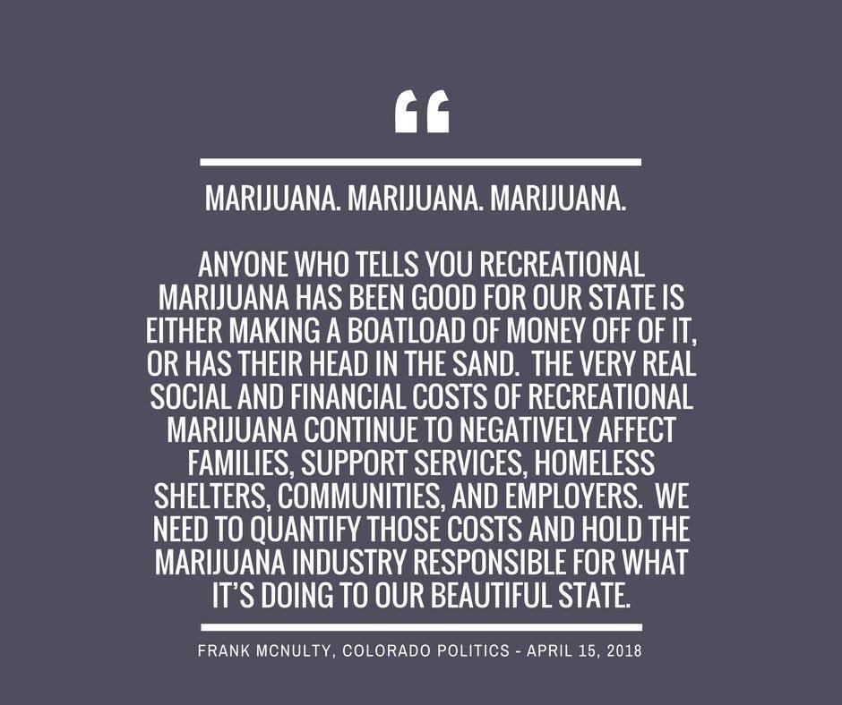
What is happening today: Share Your Truth

Slide 40
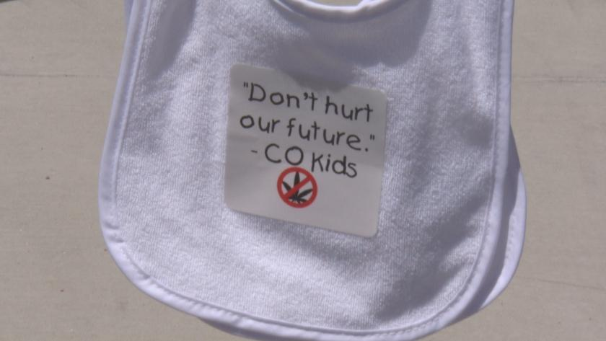
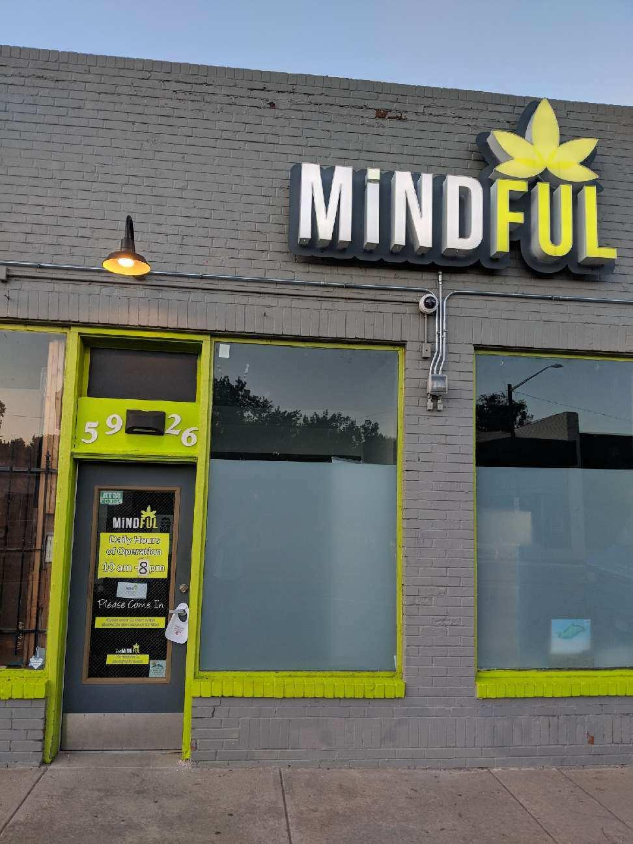
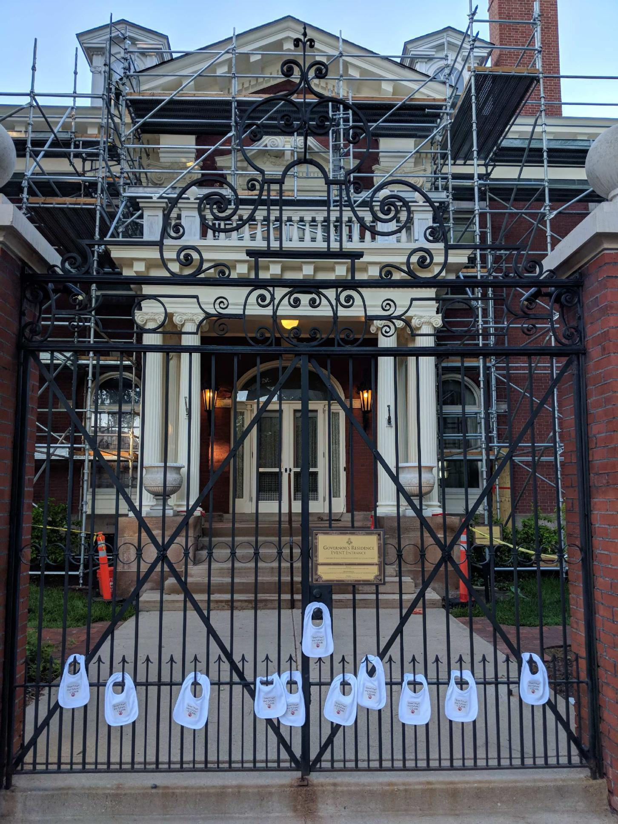
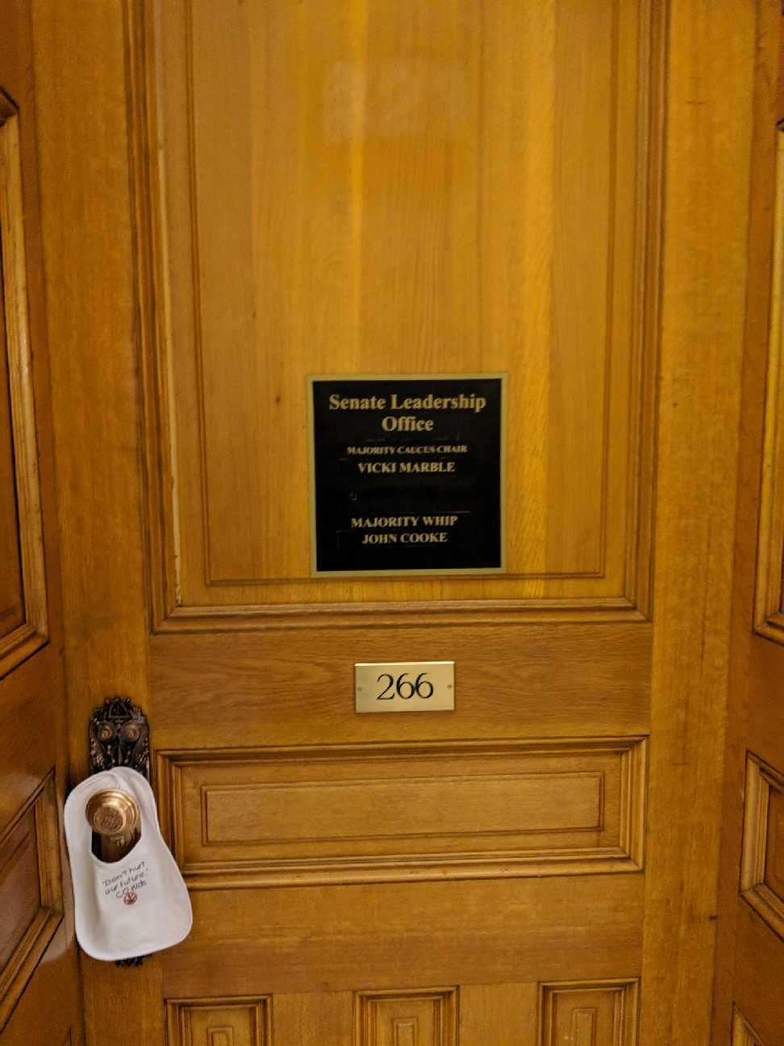
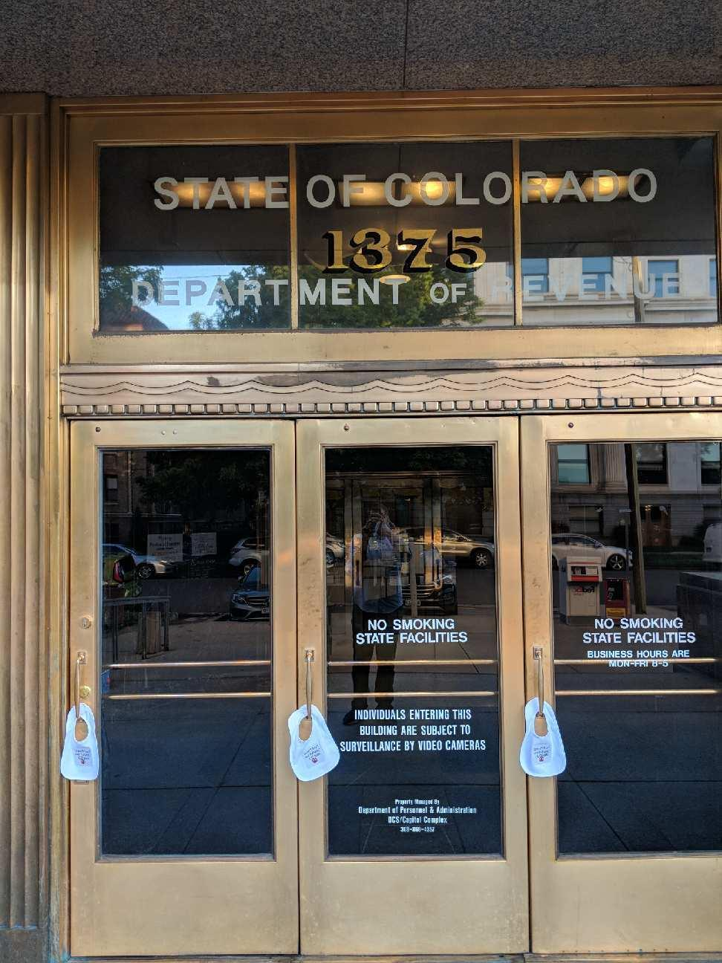
Pot and Pregnancy Do Not Mix

Slide 41
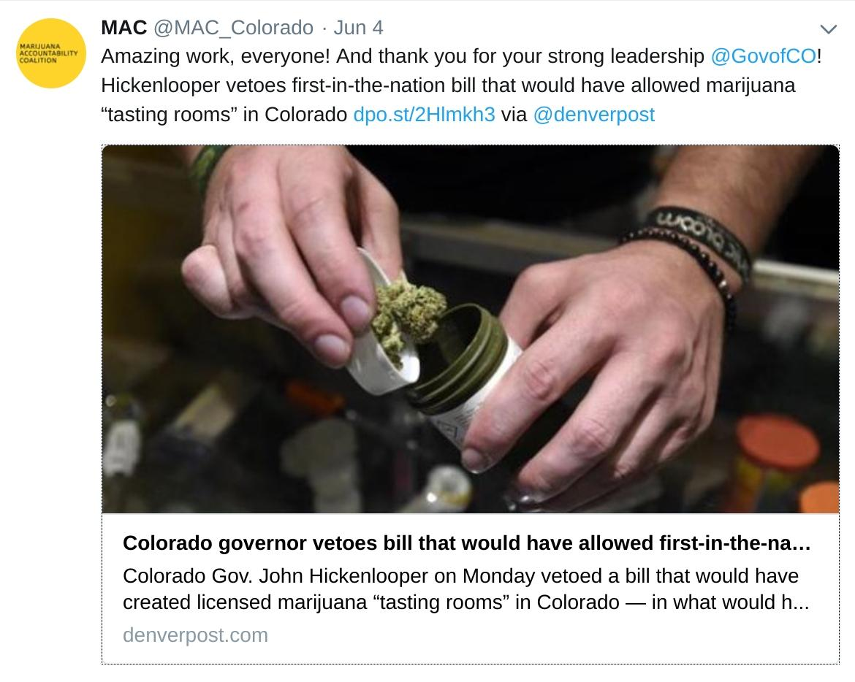
What is happening today: Governor Veto

Slide 42
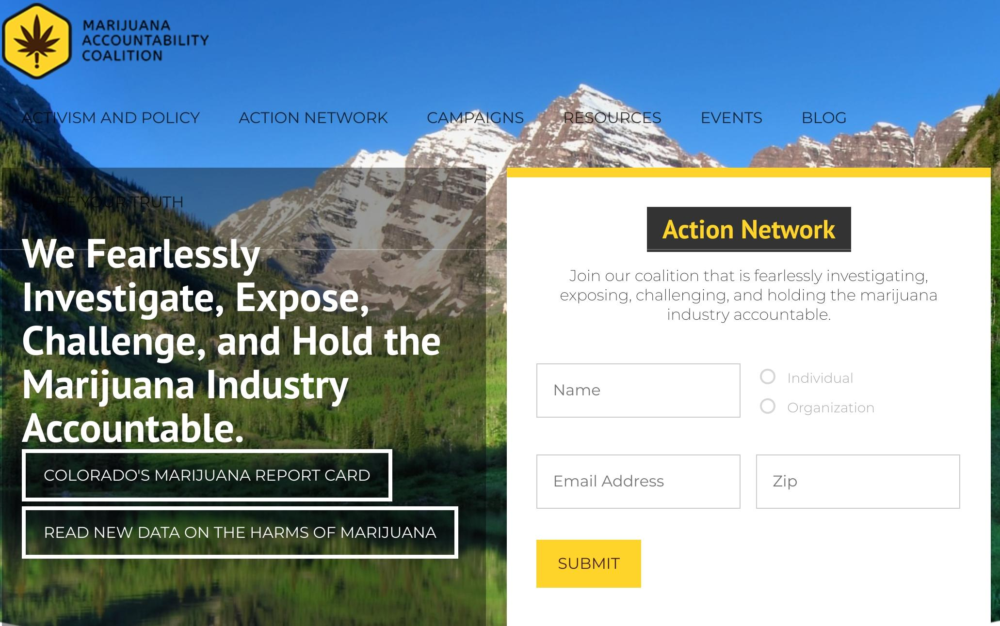
Join the Action Network

Slide 43
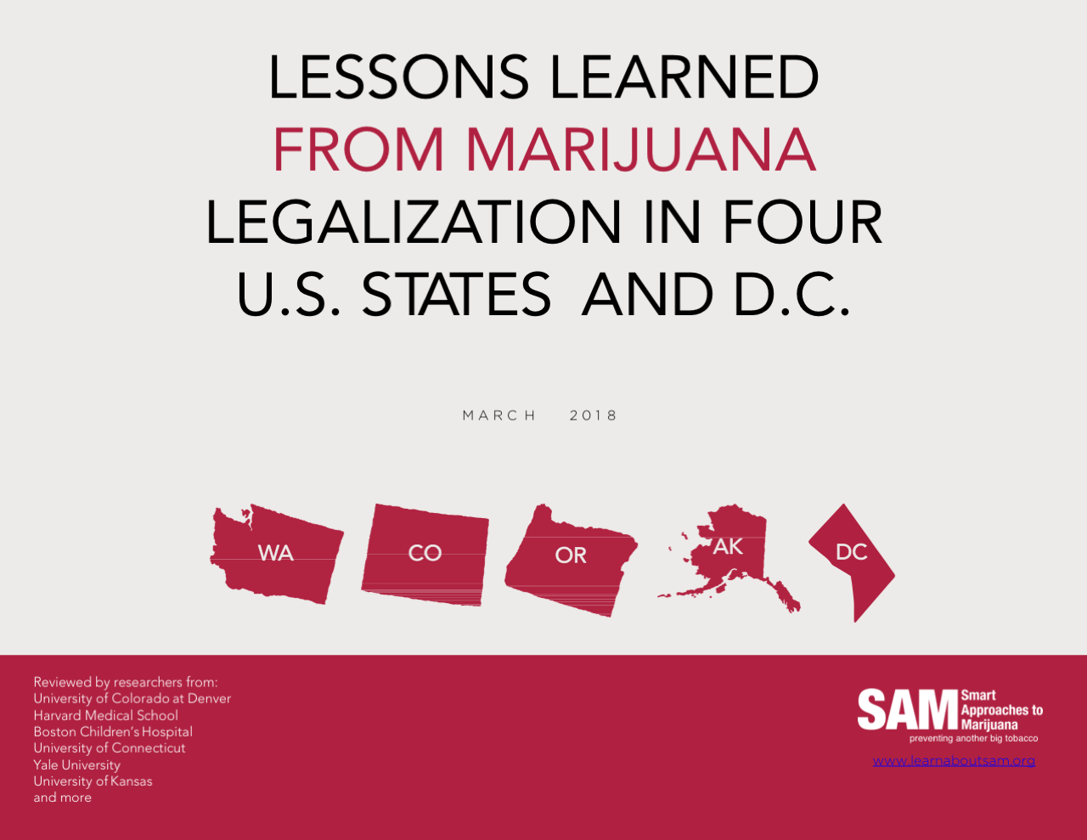

Slide 44
Contact us
www.learnaboutsam.org
http://marijuanaaccountability.co
jlr@marijuanaaccountability.co

